Slide 1
Tracing the transmission of
Covid-19 virus in Social Gatherings
s
By Co[vi]de Warriors
Janaki Sarrabu -janaki_sarrabu@optum.com
Sai Manogna Nallamothu -nallamothusai.manogna@optum.com
Shweta Saini -shweta_saini10@optum.com
Shamshad Gilani - shamshad_gilani@optum.com
Soundarya Chalika -chalika_soundarya@optum.com
Women Co[vi]de Warriors Hackathon

Slide 2
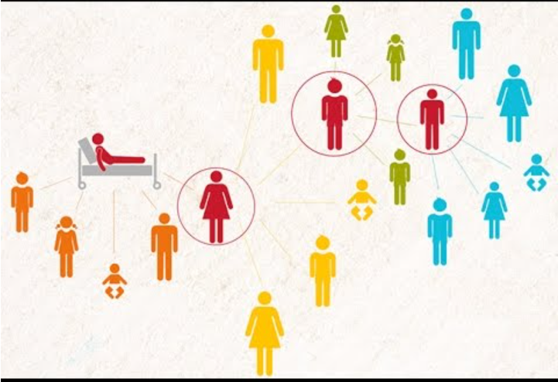
What is Contact Tracing?
Contact tracing aims to identify and alert people who have come into contact with person infected with corona virus

Slide 3
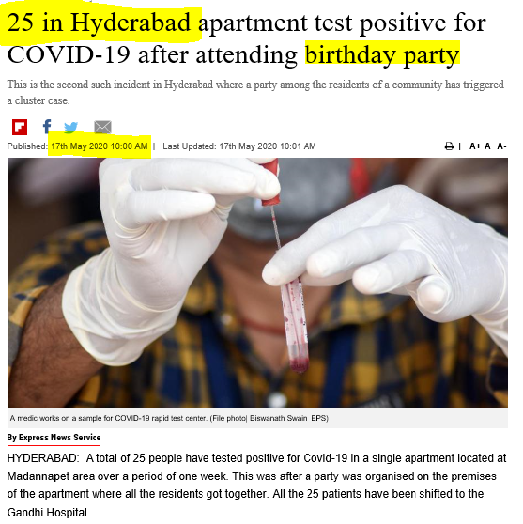
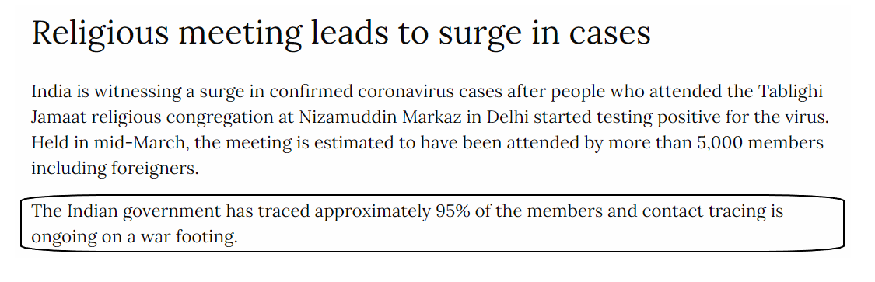
Why is Contact Tracing important
Recently it is seen that public gatherings has caused a surge in number of positive covid cases.
To halt the spread of the deadly virus, health experts say states need to hire contact tracers to quickly hunt down everyone who’s been exposed.
References:
https://www.newindianexpress.com/cities/hyderabad/2020/may/17/25-in-hyderabad-apartment-test-positive-for-covid-19-after-attending-birthday-party-2144432.html
https://www.aljazeera.com/news/2020/04/tablighi-jamaat-event-india-worst-coronavirus-vector-200407052957511.html

Slide 4


OUR MISSION
Our Mission is to protect our people with the information required when they would have risk to contact a covid-19 patient in the event they participated .
Government officials can get all the details and trace people who got affected or have a chance of infection based on the information which is provided by Host while registering in our application.

Slide 5
THE 5 W’s
Who will get benefit from this product?
Any Host who wants to organize any kind of social event can raise request online for approval from Local authority in such pandemic situation.
Host will get online approval or rejection consent with no much delay.
Government Officials can easily trace people in case of any risk related to covid spread.
What is your idea (system, product, process, service, etc.) and what does it look like? What competition exists for this idea?
It’s a service, which will provide automatic approval for the host of the event to conduct it and alert the guests to take proactive steps in case of a foreseeable covid case observed in the event.
Currently there is no such online application to serve this purpose.

Slide 6
When do you think users want it and when it could be delivered?
In case of any Covid positive case found, This solution is extremely helpful to trace down the affected person registered under our application and alert to other participants in the same event exposed to potential risk
Where should it be delivered, (in the cloud, hosted, or premise-based for products) as face-to-face services, in the doctor’s office, etc.?
This product should be hosted on cloud virtual servers
Why do we need such application?
This solution is of potential use to local authorities to trace affected people in very short time and minimize the spread.
Currently it takes atleast a few days for them to do so with inaccurate/minimal information they collate.

Slide 7
Proposed solution
We have built a technology solution which will help local authorities to regulate the events and collect the event information and trace people if required .
It also helps Host of event to get a hassle free registration of event and protect the respective attendees in case of risk of Covid infection.
The program is automated to check if any of the guests and host (based on Aadhar details) are part of current active list of Covid patients
It also will check the event location belongs to any of the containment zones.
The Solution will collate Aadhar details of attendees, hosts, other event details and provide them to local law enforcement authorities when required.

Slide 8












Flow Of Code
Save the details of given input and run the approval process using (JSP and My SQL Database)
Local authority can check and alert impacted attendees and host
Request for event approval from a host or organizer with event location details and participant list
Informing to host regarding approval or rejection based on risk identified
Covid patient’s database,
Aadhar Database
and Containment zone list

Slide 9
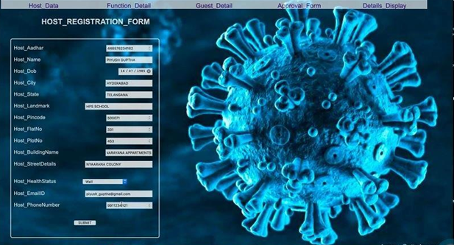
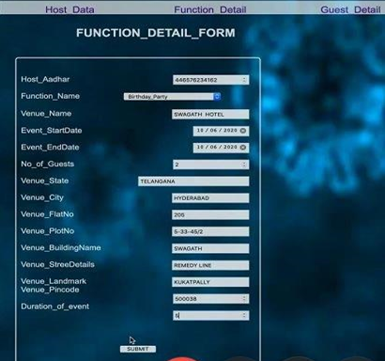
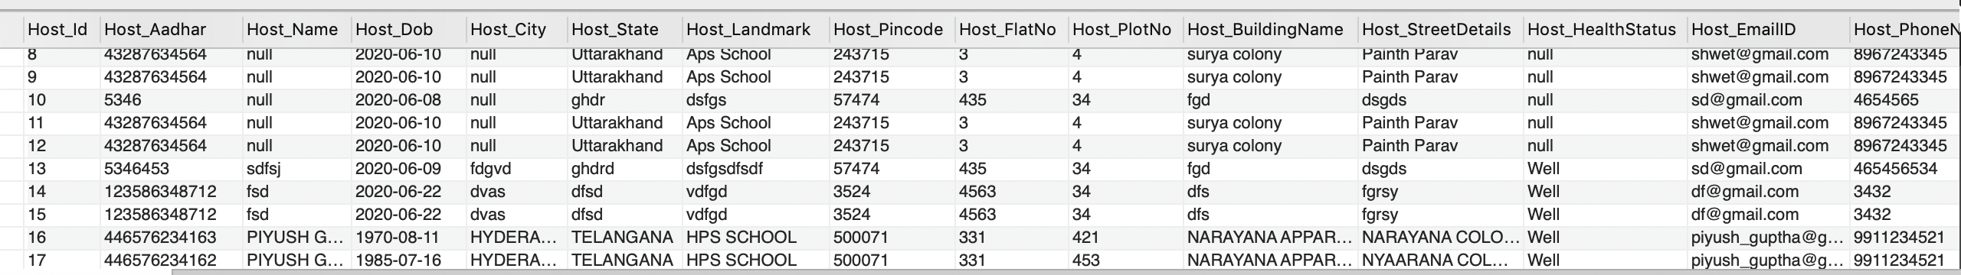
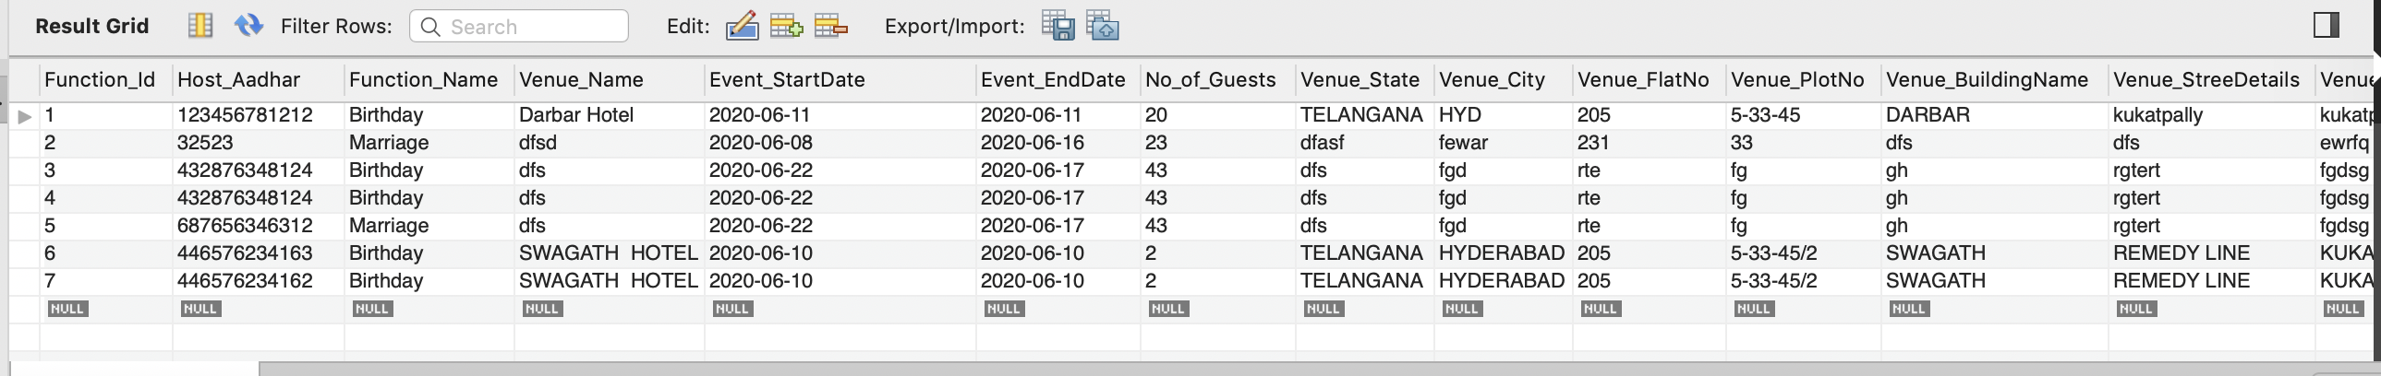
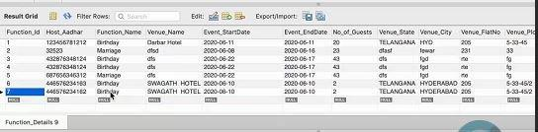
Application Demo
Host Database
Function Database

Slide 10
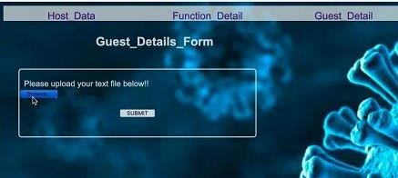
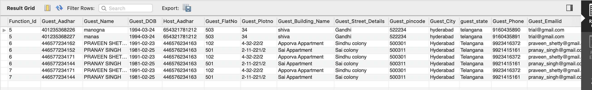
Application Demo

Slide 11
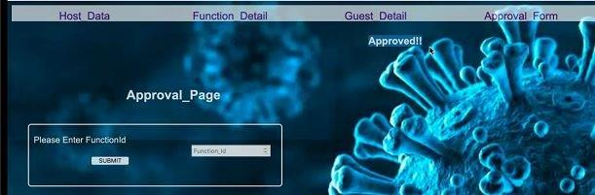
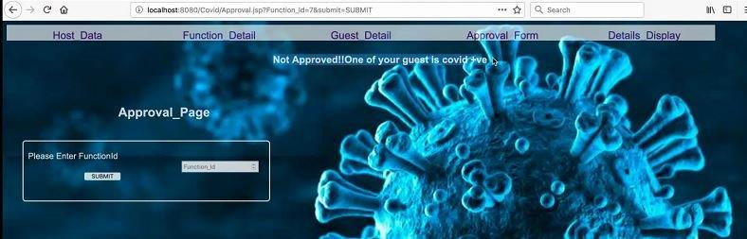
Application Demo
Approval Pop Up
Rejection Pop Up

Slide 12
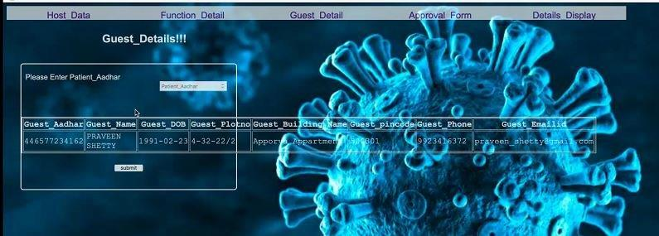
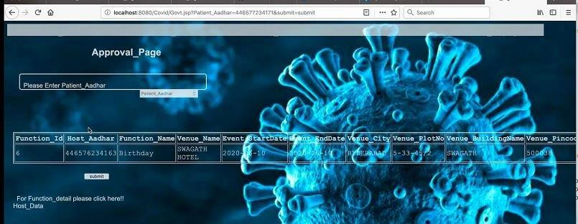
Application Demo
Feature for Government Officials to fetch the Co-participant’s list of the event attended by identified Covid Patient
Approval Pop up
Feature for Government Officials to fetch the Host and Event details attended by identified Covid Patient

Slide 13


Future Enhancements
Mobile Application can be built for this new service
All the affected guest and host and even event location owner can be alarmed by an SMS if risk is observed by local authorities.
This Solution can be used to conduct events under any emergency situations and for Security purposes.

Slide 14
Github Link : https://github.com/shweta243/Ctrl_Alt_Elite
Demo Youtube link: https://youtu.be/0BsKVcD81-g

Slide 15
Thank You

